Slide 1
CS2422 Assembly Language & System Programming
December 2, 2003

Slide 2
Today’s Topic
Machine Independent Assembler Features
  Literals
  Symbol Defining Statements
  Expressions
  Program Blocks
  Control Sections and Program Linking

Slide 3
Study Guide
Section 2.3 of Beck’s “System Software” book.

Slide 4
Literals
Design idea
  Let programmers to be able to write the value of a constant operand as a part of the instruction that uses it.
  This avoids having to define the constant elsewhere in the program and make up a label for it.
Example (Fig. 2.10)
  45 001A ENDFIL LDA =C’EOF’ 032010
  93 LTORG
  002D * =C’EOF’ 454F46
  215 1062 WLOOP TD =X’05’ E32011

Slide 5
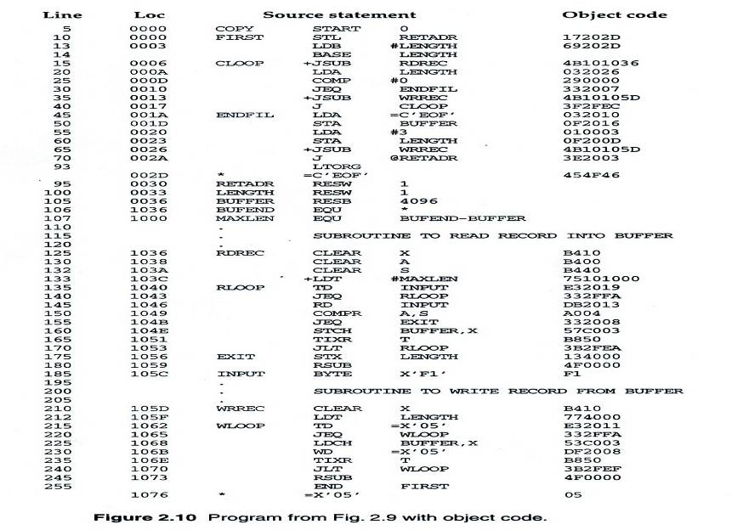
Fig. 2.10

Slide 6
Literals vs. Immediate Operands
Immediate Operands
  The operand value is assembled as part of the machine instruction
  e.g. 55 0020 LDA #3 010003
Literals
  The assembler generates the specified value as a constant at some other memory location
  e.g. 45 001A ENDFIL LDA =C’EOF’ 032010
Compare (Fig. 2.6)
  e.g. 45 001A ENDFIL LDA EOF 032010
  80 002D EOF BYTE C’EOF’ 454F46

Slide 7
Literal - Implementation (1/3)
Literal pools
  Normally literals are placed into a pool at the end of the program
    See Fig. 2.10 (END statement)
    255 END FIRST
    1076 * =X’05’ 05
  In some cases, it is desirable to place literals into a pool at some other location in the object program
    Assembler directive LTORG
    Reason: keep the literal operand close to the instruction

Slide 8
Literal - Implementation (2/3)
Duplicate literals
  e.g. 215 1062 WLOOP TD =X’05’
  e.g. 230 106B WD =X’05’
  The assemblers should recognize duplicate literals and store only one copy of the specified data value
    Comparison of the defining expression
      Same literal name with different value, e.g. LOCCTR=*
    Comparison of the generated data value
      The benefits of using generate data value are usually not great enough to justify the additional complexity in the assembler

Slide 9
Literal - Implementation (3/3)
LITTAB
  Literal name, the operand value and length, the address assigned to the operand
Pass 1
  Build LITTAB with literal name, operand value and length, leaving the address unassigned
  When LTORG statement is encountered, assign an address to each literal not yet assigned an address
Pass 2
  Search LITTAB for each literal operand encountered
  Generate data values using BYTE or WORD statements
  Generate modification record for literals that represent an address in the program

Slide 10
Symbol-Defining Statements (1/2)
Labels on instructions or data areas
  The value of such a label is the address assigned to the statement
Defining symbols
  Symbol EQU Value
  Value can be: constant, other symbol, expression
  Making the source program easier to understand
  No forward reference

Slide 11
Symbol-Defining Statements (2/2)
Example 1
  MAXLEN EQU 4096
  +LDT #MAXLEN
Example 2
  BASE EQU R1
  COUNT EQU R2
  INDEX EQU R3
Example 3
  MAXLEN EQU BUFEND-BUFFER
  +LDT #4096

Slide 12
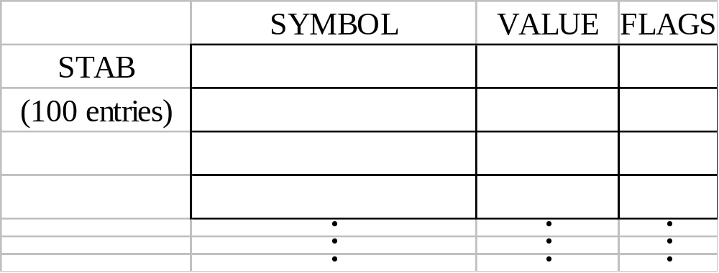
ORG (origin)
Indirectly assign values to symbols
Reset the location counter to the specified value
    ORG value
Value can be: constant, other symbol, expression
No forward reference
Example
  SYMBOL: 6bytes
  VALUE: 1word
  FLAGS: 2bytes
  LDA VALUE, X

Slide 13
ORG Example
Using EQU statements
  STAB RESB 1100
  SYMBOL EQU STAB
  VALUE EQU STAB+6
  FLAG EQU STAB+9
Using ORG statements
  STAB RESB 1100
  ORG STAB
  SYMBOL RESB 6
  VALUE RESW 1
  FLAGS RESB 2
  ORG STAB+1100

Slide 14
Expressions
Expressions can be classified as absolute expressions or relative expressions
  MAXLEN EQU BUFEND-BUFFER
  BUFEND and BUFFER both are relative terms, representing addresses within the program
  However the expression BUFEND-BUFFER represents an absolute value
When relative terms are paired with opposite signs, the dependency on the program starting address is canceled out; the result is an absolute value

Slide 15
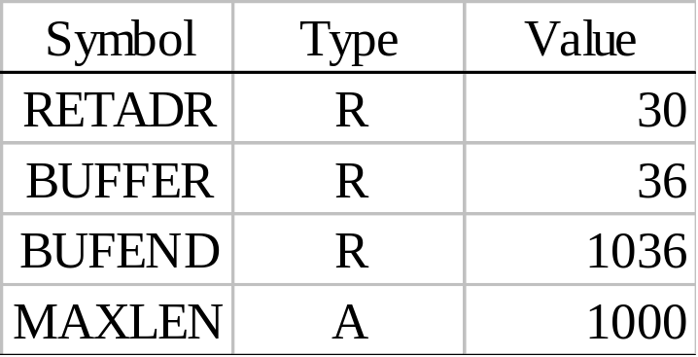
SYMTAB
None of the relative terms may enter into a multiplication or division operation
Errors:
  BUFEND+BUFFER
  100-BUFFER
  3*BUFFER
The type of an expression
  keep track of the types of all symbols defined in the program

Slide 16
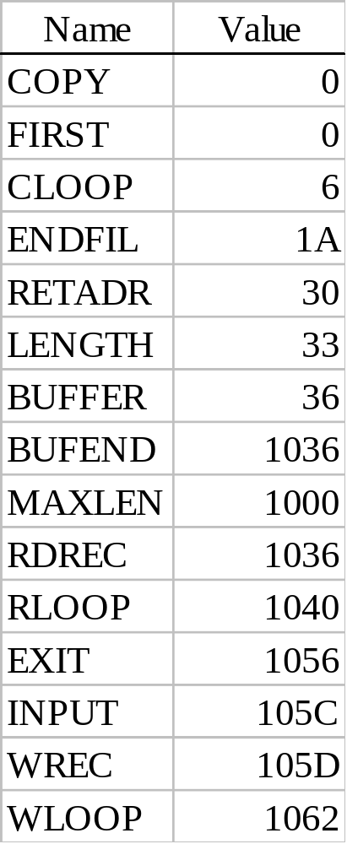
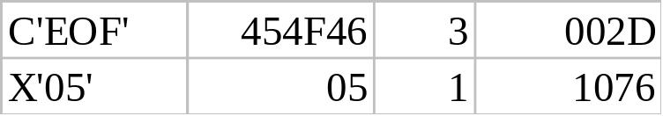
Example 2.9
SYMTAB LITTAB

Slide 17
Program Blocks
Program blocks
  Refer to segments of code that are rearranged within a single object program unit
  USE [blockname]
  At the beginning, statements are assumed to be part of the unnamed (default) block
  If no USE statements are included, the entire program belongs to this single block
  Example: Figure 2.11
  Each program block may actually contain several separate segments of the source program

Slide 18
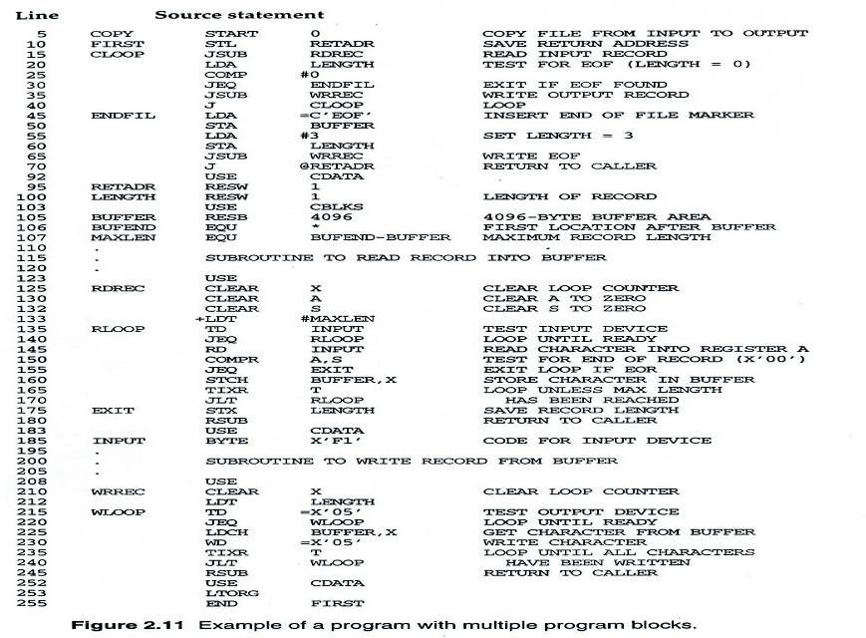
Figure 2.11

Slide 19
Program Blocks - Implementation
Pass 1
  Each program block has a separate location counter
  Each label is assigned an address that is relative to the start of the block that contains it
  At the end of Pass 1, the latest value of the location counter for each block indicates the length of that block
  The assembler can then assign to each block a starting address in the object program
Pass 2
  The address of each symbol can be computed by adding the assigned block starting address and the relative address of the symbol to that block

Slide 20
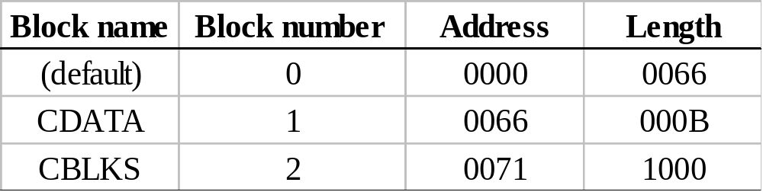
Figure 2.12
Each source line is given a relative address assigned and a block number
For absolute symbol, there is no block number
  line 107
Example
  20 0006 0 LDA LENGTH 032060
  LENGTH = (Block 1) + 0003 = 0066 + 0003 = 0069
  LOCCTR = (Block 0) + 0009 = 0009

Slide 21
Program Readability
Program readability
  No extended format instructions on lines 15, 35, 65
  No needs for base relative addressing (line 13, 14)
  LTORG is used to make sure the literals are placed ahead of any large data areas (line 253)
Object code
  It is not necessary to physically rearrange the generated code in the object program
  See Fig. 2.13, Fig. 2.14

Slide 22
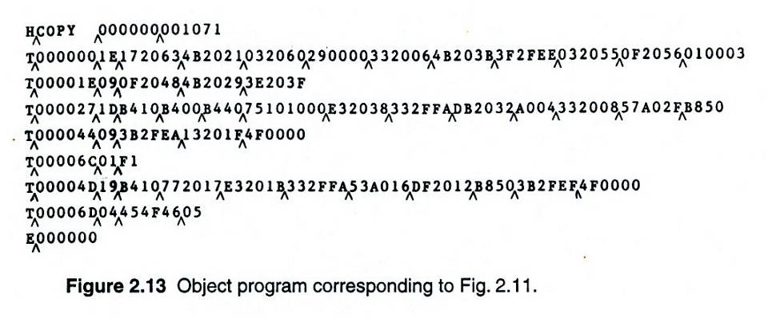
Figure 2.13

Slide 23
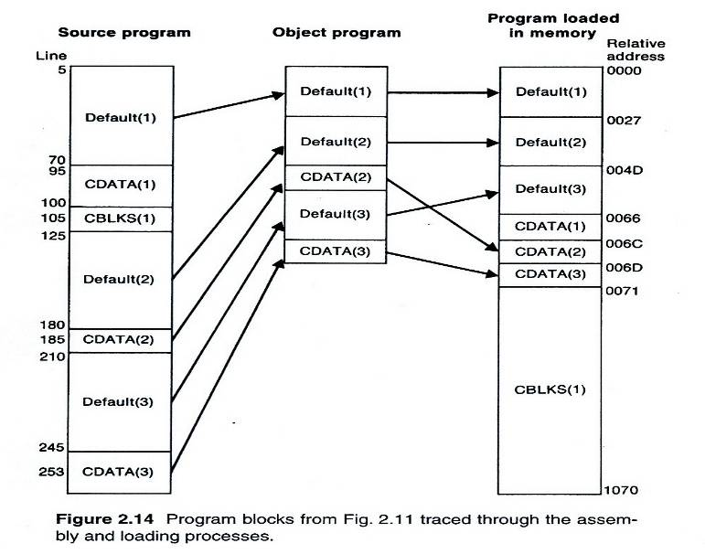
Figure 2.14

Slide 24
Control Sections and Program Linking
Control Sections
  Are most often used for subroutines or other logical subdivisions of a program
  The programmer can assemble, load, and manipulate each of these control sections separately
  Instruction in one control section may need to refer to instructions or data located in another section
  Because of this, there should be some means for linking control sections together
  Fig. 2.15, 2.16

Slide 25
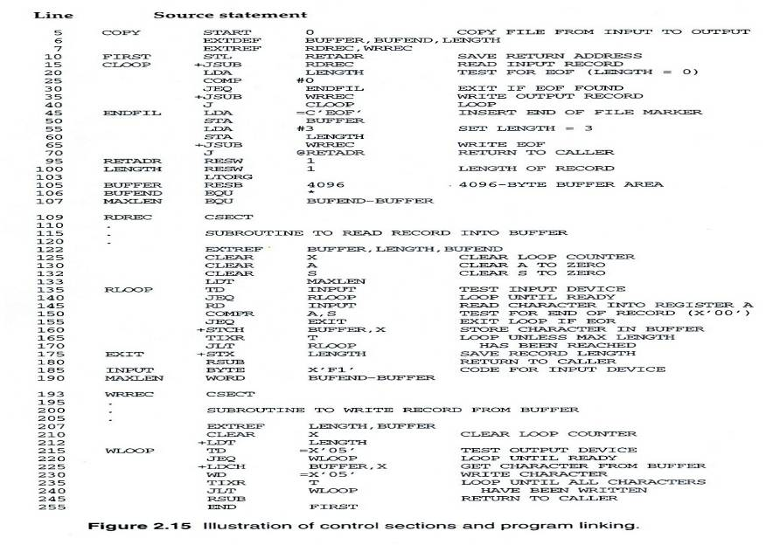
Figure 2.15

Slide 26
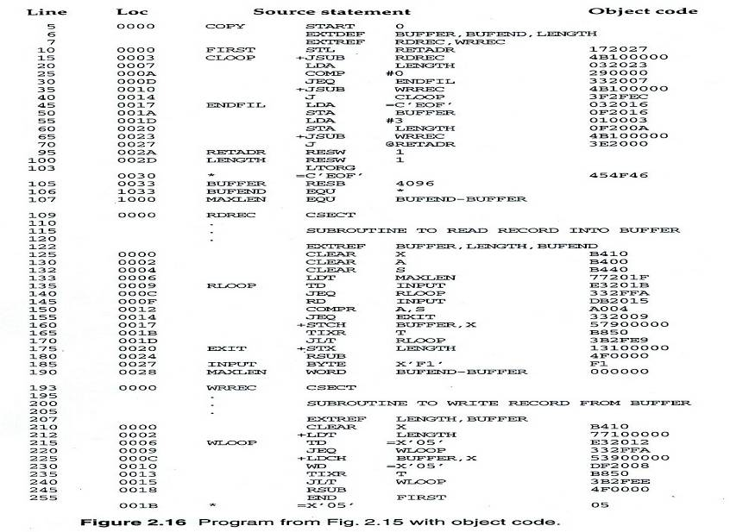
Figure 2.16

Slide 27
External Definition and References
External definition
  EXTDEF name [, name]
  EXTDEF names symbols that are defined in this control section and may be used by other sections
External reference
  EXTREF name [,name]
  EXTREF names symbols that are used in this control section and are defined elsewhere
Example
  15 0003 CLOOP +JSUB RDREC 4B100000
  160 0017 +STCH BUFFER,X 57900000
  190 0028 MAXLEN WORD BUFEND-BUFFER 000000

Slide 28
Implementation
The assembler must include information in the object program that will cause the loader to insert proper values where they are required
Define record
  Col. 1 D
  Col. 2-7 Name of external symbol defined in this control section
  Col. 8-13 Relative address within this control section (hexadeccimal)
  Col.14-73 Repeat information in Col. 2-13 for other external symbols
Refer record
  Col. 1 R
  Col. 2-7 Name of external symbol referred to in this control section
  Col. 8-73 Name of other external reference symbols

Slide 29
Modification Record
Modification record
  Col. 1 M
  Col. 2-7 Starting address of the field to be modified (hexiadecimal)
  Col. 8-9 Length of the field to be modified, in half-bytes (hexadeccimal)
  Col.11-16 External symbol whose value is to be added to or subtracted from the indicated field
  Note: control section name is automatically an external symbol, i.e. it is available for use in Modification records.
Example
  Figure 2.17
  M00000405+RDREC
  M00000705+COPY

Slide 30
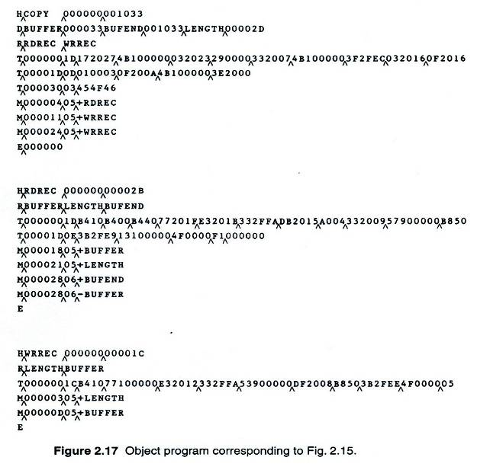
Figure 2.17

Slide 31
External References in Expression
Earlier definitions
  Required all of the relative terms be paired in an expression (an absolute expression), or that all except one be paired (a relative expression)
New restriction
  Both terms in each pair must be relative within the same control section
  Ex: BUFEND-BUFFER
  Ex: RDREC-COPY
In general, the assembler cannot determine whether or not the expression is legal at assembly time. This work will be handled by a linking loader.

